Slide 1
Progress Report: Nakuja N3
AIRFRAME TEAM • 02.07.2023

Slide 2
Overview
Expected delivery
February 8th,2023
Recent progress
Finalise on CAD designs
Calculated estimates of design parameters(drag,Cfd etc)
Make design selection(dimensions)
Yet to be finalised
Research on selection and fabrication techniques to be used
Generation of the B.O.M

Slide 3
Progress - Finalise on Airframe design
Accomplishment 1
We settled for the togo design of the said proposed rocket.
The solid work files and step files of the design were already shared.
Accomplishment 2
The dimensions of each part was settled upon based on the simulations we did in OpenRocket.
Find the specifications of the rocket design in the next slide.

Slide 4
Progress - Finalise on Airframe design
Design specifications.
Airframe dimensions:
Airframe length = 185.5 cm ( 25 cm nose cone ,75cm tail tube + motor mount, 80cm avionics bay + piston ejection, extra 5.5cm is due to the internal couplers joining the tubes together)
Total avionics bay length = 40cm
Total avionics bay tube length = 80cm (40cm avionics bay ; 40cm piston ejection)

Slide 5
Progress - Finalise on Airframe design
Design specifications.
Airframe dimensions:
Coupler diameter = 79 cm in consideration to the body tube inner diameter set at 80 cm
We propose to add a shock absorber in the bay to prevent the electronics from being destroyed during launch. Proposed material is the Styrofoam sheet

Slide 6
Progress - Finalise on CAD designs
Accomplishment 1
We finalised on the CAD designs in Solidworks and Fusion 360
The work has been shared for inputs and positive critique to know where to improve.
Accomplishment 2
We want to proceed to fabrication the avionics bay and nose cone before week ends and see how the part fit together.
Yet to finalise on the launchpad design.

Slide 7
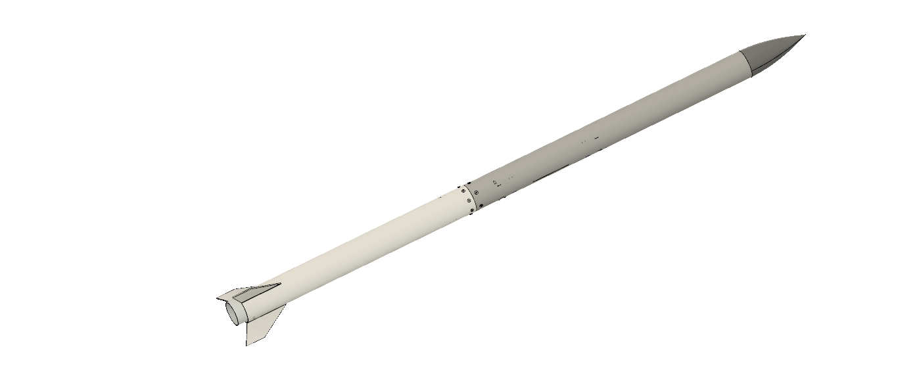
Airframe design on solidworks
Total length = 185.5cm

Slide 8
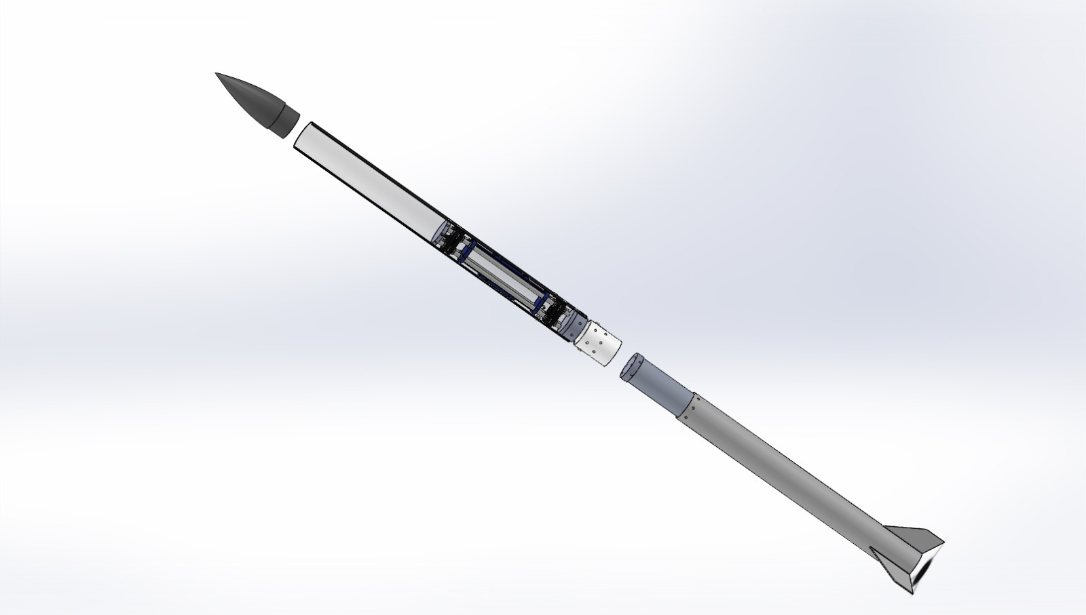
Exploded view of the airframe
Total length = 185.5cm

Slide 9
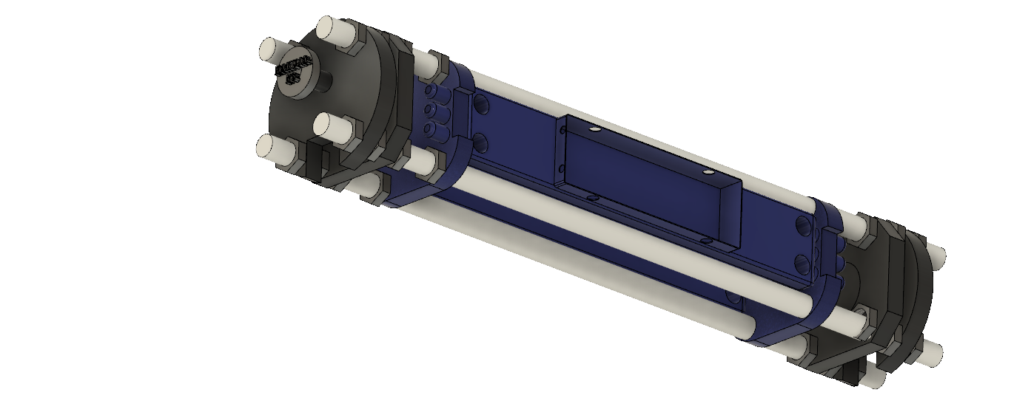
Avionics design Fusion 360
Total length = 40cm

Slide 10
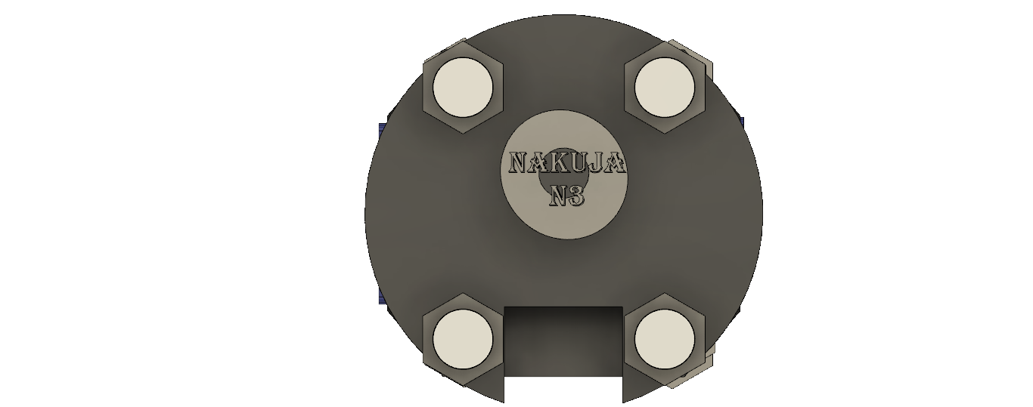
Avionics design Fusion 360
Total coupler diameter = 7.9 cm to give the airframe the orientation of the body tube

Slide 11
Progress - Calculated estimates of design parameters
Accomplishment 1
We did some calculations of the design parameters based on the simulations we did on Open rocket.
Accomplishment 2
The specifications are pointed out below.
The research document showing how these calculations were arrived at will be posted to github for reference.

Slide 12
Progress - Calculated estimates of design parameters
Applied compressive load =700N
The load applied is less than the maximum load the rocket tube can handle(60kN). The rocket is safe from compression loads during flight.
Maximum buckling load that the airframe can handle =770kN
This is the actual (crushing) compressive force that might be exerted on the airframe upon landing.

Slide 13
Progress - Calculated estimates of design parameters
Total drag coefficient = 0.5146
This was arrived at using the open rocket simulation velocity and acceleration at apogee.
Total apogee as of now;
The apogee reached by the given dimensions above and the Nakuja motor specified by the Propulsion team was approximately = 2809m

Slide 14
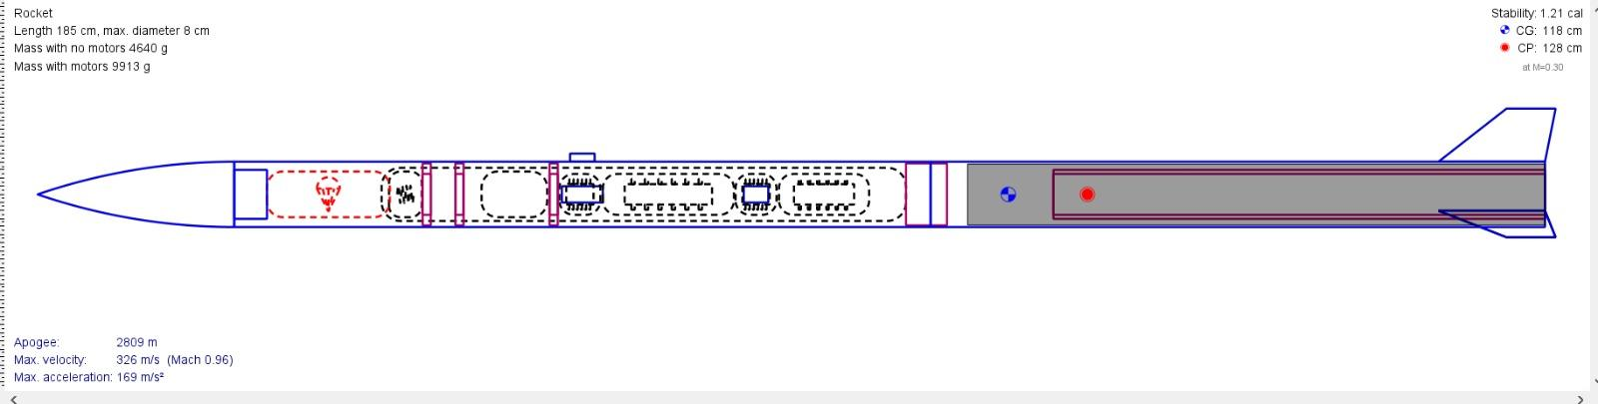

Slide 15
Attention areas
1
Come up with the BOM
Finalise on the launchpad redesigns
2
Settle on the blast deflector material that would handle the heat during launch.

Slide 16
Goals for next week
3D printing of the avionics bay
Fabrication of the airframe(Fibre glass)
Revision of the parameters
Finalise on the launchpad redesign.
Design of the fin alignment jig

Slide 17
THANKYOU

